Slide 1
SVM based vertical handovers
Anant sharma -17uec019
Ayush Maheshwari -17uec034
Kartik Singhal -17uec062
Ritik Agarwal - 17uec093
Mentor: Dr. Akash Gupta

Slide 2
Introduction
Aim
The growth in data traffic in indoor wireless networks is explosive and with greater service demands comes greater data rate demand.
In future high data rate will be needed for applications such as robotics,IOT,self driving cars,etc.
To ensure high data rates lot of development has happened in LIFI technology which has the capability to increase the data rates to around 100 times than that of WIFI technology
So in this project the aim was to build a hybrid LiFi-WiFi system to get rid of problems of LIFI technology while ensuring high data rates.
Notes:
As we are moving towards a digital era the demand for better and fast network technologies are very essential. One answer to this demand is LIFi technology. It provides 100 times better data rate when compared to Wifi. And so as to have the best data rate, the aim of this project was to overcome the problems of lifi

Slide 3
The Area of Work
LIFI-WIFI together can be used and handover between the two can ensure continuous data transfer.
We analyzed different machine learning algorithms and came up with SVM as the most accurate model.
We also created a data-set that contained all the relevant variables needed to predict the target variable(the state of the network).
We compared our technique with other techniques to measure the performance of our model
At last we analyzed the model more to ensure that our model is robust enough and can be deployed for practical data-sets.

Slide 4
Problem Addressed
A WIFI is known to provide a data rate of 32 mbps maximum, but LIFI can provide a data rate of 100 times more than that of WIFI
Problem with LIFI is
It is sensitive to blockage
Easily blocked by walls,furniture and other obstacles.
To tackle blockage we will use a hybrid system of WIFI and LIFI .
If LIFI gets blocked we will do a handover to WIFI.
Machine Learning algorithms will be used for handover.

Slide 5
WIFI only systems
Currently the indoor wireless networks are greatly dependent on WIFI technology.
Working
WIFI uses radio waves to modulate the message
Message is transferred with the help of WIFI router.
Problem with WIFI
High congestion on spectrum.
These frequencies also harm human health.
Data rate provided by WIFI is also low when compared to LIFI
Therefore we need an alternate system (Like LIFI)
It will reduce congestion on radio spectrum.
Help provide high data rate.

Slide 6
LIFI over WIFI (only LIFI systems)
Working
LIFI modulates data on the high frequency visible light waves using light emitting diodes (LEDs).
It employs photodiodes (PDs) to detect the received optical signals.
Advantages
100 times high data rate than WIFI.
Safety to human health.
High security and a wide free licensed spectrum which overcomes the problem of radio spectrum congestion.
Problems with LIFI
Blocked by obstacles as light waves cannot travel through solid objects like walls,furniture,etc.

Slide 7
6. Hybrid LIFI -WIFI systems
Hybrid LIFI -WIFI systems can be made to deal with the problem of channel blockage in LIFI systems.
This system will provide both high data rate and stable service to users.
The main idea here is to switch to WIFI whenever LIFI channel suffers from blockage.

Slide 8
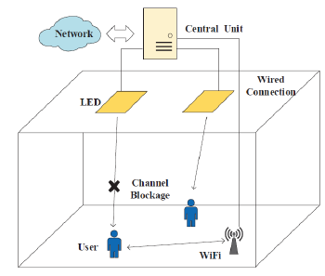
System model for hybrid LIFI-WIFI systems
A WiFi access point is placed in the corner to provide coverage for the entire room,WIFI rate remains constant.
LEDs are installed on the ceiling, and each of them acts as a LiFi access point.
When a user accesses to LiFi, it will connect to the nearest LiFi AP.
There is a central unit in the room deciding the network access should be from LIFI or WIFI for each user.

Slide 9
Working
There can be two ways in which handover can occur between LIFI and WIFI modules.
Immediate-vertical handover
SVM based vertical handover

Slide 10
Immediate-vertical handover
We will immediately switch to WIFI in case of LIFI channel blockage.
The user will switch back to LIFI if blockage disappears .
It ensures continuity of data transfer.
Disadvantages
Frequent handovers between WIFI LIFI reduce effective of data transmission.
This leads to low equivalent data rate.

Slide 11
SVM based vertical handover
Instead of immediately switching to WIFI when LIFI channel blockage occurs we can use support vector machine model.
This reduce number of frequent handovers and thus increases effective data rate.
Central unit should be able to predict the network access type on the basis of the information of various channel blockage parameters provided to it.
Model should not over-fit else it will provide vague results.
Simulation results show that this scheme can achieve higher equivalent data rate for users.

Slide 12
Literature Survey
Kaixuan Jiyz, Tianqi [1] : This research paper was based on the necessary parameters that come into play while using LIFI and WIFI together and their right values so to as to create a dataset that can be used to create an SVM model.
Daniela Alexandra Embus [2] : This research is based on supervised learning on a larger scale.The types of handovers, how can they be used are listed in this paper and how a user with his phone if moves in a room with multiple access points can be connected to the best access point using handover and machine learning technique at different point of time
DeepMIMO [3] : This research paper is based on millimeter wave based base stations that are assumed to be aligned in a street and a lot of users are assumed at different points of street and the user is able to connect to the best station with least blockage at any point in the street.

Slide 13
Problems in literature
Overfitting and Underfitting
Overfitting occurs when model learns detail and noise in training data. This learning does not apply to new data.
Underfitting refers to a model that can neither model the training data nor generalize to new data
In literature underfitting and overfitting is not dealt with.

Slide 14
Hyperparameter tuning
Parameters which define the model architecture are referred to as hyper parameters.
Process of searching for ideal model architecture is referred to as hyperparameter tuning.
To get accurate results hyperparameter tuning is must.
In literature hyperparameter tuning is not done for best results.

Slide 15
Problem Statement
To build a hybrid WIFI-LIFI system.
Using machine learning models to do a handover between WIFI-LIFI modules.
To take care of overfitting and underfitting of model.
To find best hyperparameters for model.

Slide 16
Methodology
First we created a dataset based on different blockage parameters and their network access type to train our SVM model.
The second stage of our project was to build a model on the constructed dataset with best hyperparameters that can provide the best accuracy.
Lastly we ensured by analyzing the model more that this model can be deployed to practical values and does not overfit on the training dataset.
This model can be used to determine the network access type on providing it with the blockage parameters of the current scenario.

Slide 17
All the code was done in R language in this project and the following libraries were used:
Caret : For cross validation and model building.
ggplot : For exploratory analysis of the dataset.
e1071 : For tuning the hyper-parameters of the SVM model.
Randomforest : For tuning the hyper-parameters of random forest model.

Slide 18
Training Dataset Construction
A large number of samples are required to train and test an SVM model.
Samples are divided into train dataset (to train model) and test dataset(for calculating accuracy of trained model).
There are three parameters that are identified to determine the network access type.
We created one lac samples.

Slide 19
Parameters used for constructing dataset are:-
Blockage occurrence rate :-
number of times the communication between source and destination suffered blockage.
times of channel blockages happened during a fixed period T.
It is generally an integer between 0 and 10 if we take the fixed time period to be a minute.
Blockage occupation rate:-
ratio between the period of time when a user experiences channel blockage and the fixed time period stated above.
tells us about the time for which communication was blocked in fixed time T.
set to a real number between 0 and 1 as it is the percentage of time, blockage is experienced in time T.

Slide 20
LIFI transmission rate :-
Transmission rate provided by LIFI.
We considered our WIFI module to have a fixed transmission rate of 32 mbps.
Ideally LIFI should provide us a transmission rate of 3200 mbps.
To generalise our model we considered LIFI transmission rate to lie between 2900 to 3200 mbps.

Slide 21
Determining network access type :-
We consider three different network access types :-
Wifi Only -> User connected to wifi all time in a state the network access type is defined as “WiFi only” and is denoted as k = 1.
Lifi Only -> User connected to lifi all time in a state the network access type is defined as “LiFi only” and is denoted as k = 2.
LiFi/WiFi -> When a user should switch from LiFi to WiFi once LiFi channel blockage occurs and should switch back to LiFi after the blockage disappears in a state. It is denoted by k=3.

Slide 22
Our main aim is to provide the user with that type of network access that has maximum data rate.
Equivalent data rate at any network access type is given by (efficiency of LIFI)*(transmission rate of LIFI)+ (efficiency of WIFI)*(transmission rate of WIFI).
Efficiency of LIFI and Efficiency of WIFI for different network access type can be given by fig 3.1 and fig 3.2.
Here :-
Miu ->occupation rate vector..
Lambda -> occurence rate vector.
𝑻h-> ratio between a single vertical handover overhead and the time interval T.

Slide 23
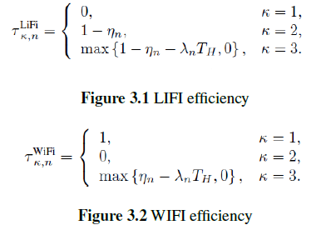

Slide 24
Model Creation
We split the whole dataset into two parts in the ratio of 7:3 - ”train” and ”test” dataset.
Train dataset -> to create our model.
Test dataset -> to validate the model’s accuracy.
We tested different machine learning algorithms such as random forest, gradient boosting etc
SVM gave best accuracy of 99.7 percent on the test dataset
Notes:
So after constructing the dataset ,Now it’s the time for model creation
.For model creation in any machine learning project We split the whole dataset into two parts in the ratio of 7:3 - ”train” and ”test” dataset.
Train dataset -> to create our model.
Test dataset -> to validate the model’s accuracy.

Slide 25
SVM (State vector machine)
To understand why SVM gave good results in this case we need to understand what SVM does !

Slide 26
SVM working.
We plot each data item as a point in n-dimensional space with the value of each feature being the value of a particular coordinate.
Then, we perform classification by finding the hyper-plane that differentiates the two or more classes very well.
In cases like fig 3.4 when classes are not linearly separable ,circular hyper-plane can be used to separate the two classes, for this SVM algorithm has a kernel trick which can fit a non-linear hyper-plane in these type of scenarios.

Slide 27
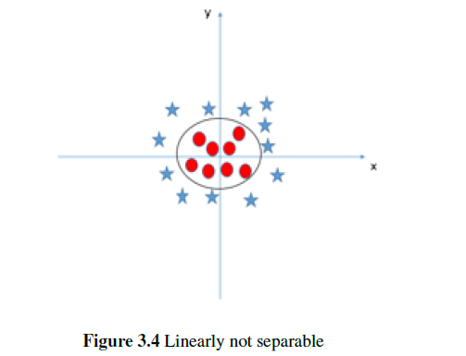
In real world data such as our LIFI data set , data points are not always Linearly separable therefore SVM model works best!

Slide 28
Hyper-parameters selection
Svm has different hyper-parameters that need to be tuned to get best results :-
Kernel :-
This hyper-parameter can have values such as ”linear”, ”polynomial”, etc.
It specifies the type of hyper-plane we want to fit on our dataset (linear or non-linear).
Degree :-
This hyper-parameter is specified only when the kernel type is ”polynomial” or ”rbf”.
Degree of the polynomial that is used to separate the classes here.

Slide 29
Gamma :-
Deals with overfitting.
This parameter directly is responsible for the extent of over-fitting, higher the value of gamma, higher is the over-fitting.
Cost :-
This parameter defines the extent of margin in a model.
Margin is the shortest distance between the data points and the hyper-plane.

Slide 30
How to get Best Hyper-Parameters ?

Slide 31
Grid Search
To get the best hyper-parameters we used grid search.
It helps us identify the best possible set of values to get the best possible accuracy.
In grid search our machine runs each and every combination of hyperparameters and checks accuracy for each combination and provides us with the best set of values.
The combination with best accuracy in our case is given as :-
Kernel -> polynomial
Degree -> 2
Gamma -> 1
Cost -> .1

Slide 32
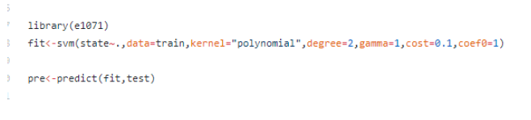
Code to build svm model in R

Slide 33
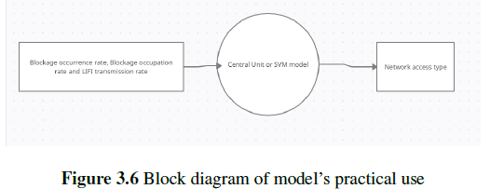
How will our svm model work?
Notes:
Any model is not of any use until we know how can this work in practical cases.
The system model shows how a central unit will decide which network access type should be provided to the user.
Central unit has this model which will classify different network access types on the basis of one lac different data points.
We just need to provide the central unit with three values - blockage occurrence rate, blockage occupation rate and the LIFI transmission rate of the user currently and hence it will give out the network access type accordingly.

Slide 34
Any model is not of any use until we know how can this work in practical cases.
The system model shows how a central unit will decide which network access type should be provided to the user.
Central unit has this model which will classify different network access types on the basis of one lac different data points.
We just need to provide the central unit with three values - blockage occurrence rate, blockage occupation rate and the LIFI transmission rate of the user currently and hence it will give out the network access type accordingly.

Slide 35
Model analysis
Is our model providing same accuracy as it is able to provide on the dataset created by us.
For this we should ensure that our model does not overfit.
So what is overfitting?

Slide 36
Overfitting
Overfitting refers to a model that models the training data too well but performs poorly on test dataset.
It happens when a model learns the details in the training data to that extent that it is unable to give same level of performance on new data.
So we can detect if our model overfits or not in two ways :-
Using k-fold cross validation
Using R-squared value

Slide 37
k-fold cross validation
Used to evaluate the skill of a machine learning model on unseen data.
A resampling technique.
We divide data set into k groups.
We keep each group as a test dataset one at a time while using others as a train dataset.
If our model is giving good accuracy without k-fold and poor accuracy with k-fold then our model is overfitted.
In this case model will serve bad results when a new data is served to it.

Slide 38
R-squared value
Tells us about the performance of that model on that particular dataset.
Ideally the difference between the R-squared value of the train dataset and test dataset should be close to 0 if our model is not overfitting.
Difference being close to 0 ensures that our model is performing equally well on train and test dataset.
Mathematically R-squared value of any data can be calculated as correlation between actual value and predicted value squared.

Slide 39
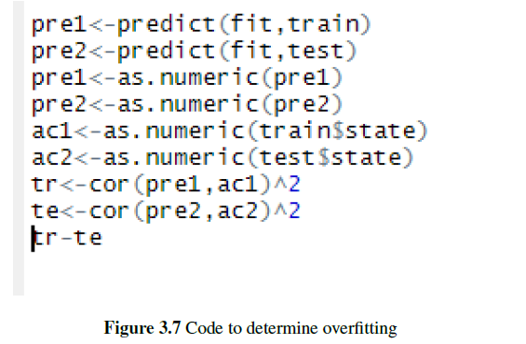
The code to take out this correlation is given in figure 3.7
In our case this value came out to be 0.003377 which is close to zero.

Slide 40
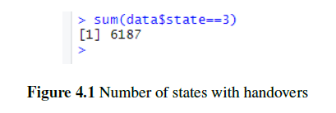
Simulation and Results
SVM based handovers ensures less handover than immediate handover case.
Only 6 percent of the scenarios will suffer handovers.

Slide 41
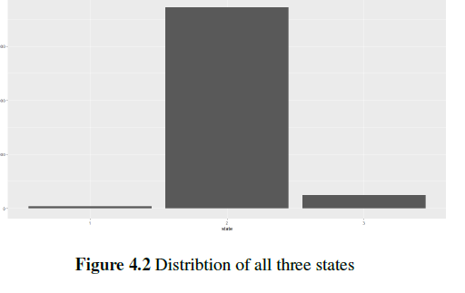
Distribution of all three states

Slide 42
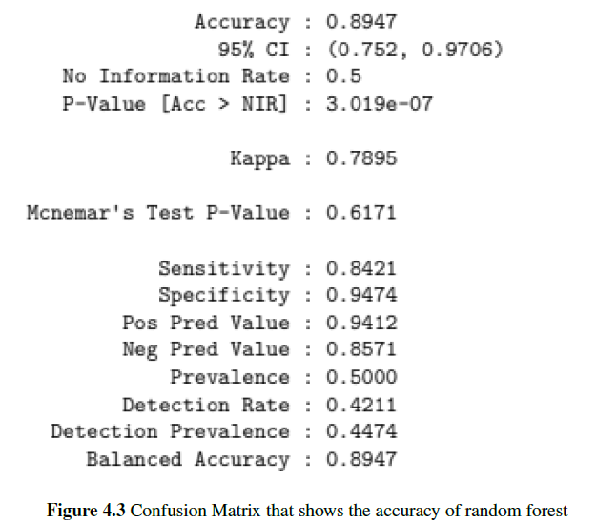
Accuracy using random forest
Using random forest algorithm on our test dataset we were able to get an accuracy of 89 percent

Slide 43
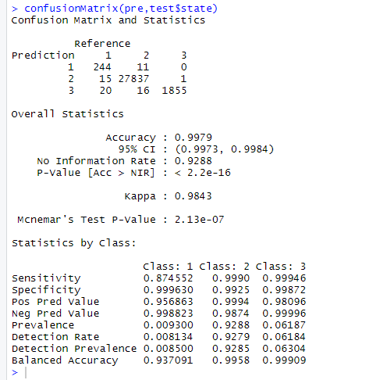
Accuracy using svm
Using svm on our test dataset we were able to get an accuracy of 99 percent

Slide 44
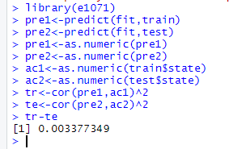
Checking overfitting condition
Difference between R-squared values of train and test dataset should be close to 0 if our model is not overfitting.
In our case it is .00337 which indicates our model is robust enough to be deployed on outside data.

Slide 45
Conclusions
We can ensure a data rate that is 100 times more than the traditional system of WIFI using this LIFI WIFI SVM based handover system.
We created one lac values to train our dataset.
We tried ensemble technique such as random forest and models such as SVM.
Most accurate model came out to be SVM.
Using test dataset we prove that svm model can give good results on outside data as well.

Slide 46
Scope of further work
This model is limited to handover between LIFI-WIFI in a particular room or a floor but this can also be implemented on larger scale such as handover between 4G-5G cells.
A model can be created which is self learning, which can be able to add new data points into it’s scope for more accurate results.

Slide 47
Bibliography
[1] Kaixuan Jiyz, Tianqi Maoy, Jiaxuan Cheny, Yuhan Dongz and Zhaocheng Wang. SVM-based Network Access Type Decision in Hybrid LiFi and WiFi Networks
[2] Ahmed Alkhateeb DeepMIMO: A Generic Deep Learning Dataset for Millimeter Wave and Massive MIMO Applications
[3] Daniela Alexandra Embus, Andres Juli´an Castillo, Fulvio Yesid Vivas, Oscar Mauricio Caicedo,and Armando Ord´o˜nez NetSel-RF: A Model for Network Selection Based on Multi-Criteria and Supervised Learning.

Slide 48
Thank You

